Slide 1
CS161 – Design and Architecture of Computer Systems
Week 5 - Discussion
*some slides adapted from:
Prof Daniel Wong UCR – EE/CS)

Slide 2
Memory vs Storage
Disk (aka: Secondary Storage):
used to store data of all your programs and everything else on the computer
often referred to as (when buying a computer):
“Storage”
“Hard Drive”
Main memory:
used to hold programs while they are running
can be thought of as a “cache” for disk storage
often referred to as (when buying a computer):
“Memory”
“Solid State Drive (SSD)”
“Flash memory” (for phones)
“RAM”

Slide 3
Memory vs Storage
Main memory:
used to hold programs while they are running
so programs are limited by size of memory??
and how do we switch programs running in memory??
Notes:
In earlier sections, we saw how caches provided fast access to recently used portions of a program’s code and data. Similarly, the main memory can act as a “cache” for the secondary storage, usually implemented with magnetic disks. This technique is called virtual memory.
virtual memory: A technique that uses main memory as a “cache” for secondary storage.
Of course, to allow multiple virtual machines to share the same memory, we must be able to protect the virtual machines from each other, ensuring that a program can only read and write the portions of main memory that have been assigned to it. Main memory need contain only the active portions of the many virtual machines, just as a cache contains only the active portion of one program.

Slide 4
Virtual Memory: Big Picture
Each program thinks it has entire computer disk to run on (“Virtual Memory”)
However, each program runs in shared main memory (“Physical Memory”)
But: main memory << disk
And: multiple programs running at once (sharing main memory)
So we have to convert virtual memory to actual physical memory or actual disk
Thus: main memory is a ”cache” for disk
Notes:
In earlier sections, we saw how caches provided fast access to recently used portions of a program’s code and data. Similarly, the main memory can act as a “cache” for the secondary storage, usually implemented with magnetic disks. This technique is called virtual memory.
virtual memory: A technique that uses main memory as a “cache” for secondary storage.
Of course, to allow multiple virtual machines to share the same memory, we must be able to protect the virtual machines from each other, ensuring that a program can only read and write the portions of main memory that have been assigned to it. Main memory need contain only the active portions of the many virtual machines, just as a cache contains only the active portion of one program.

Slide 5
Shared Physical (Main) Memory
Main Memory
Process 1
Disk
Process 2

Slide 6
Pages
Divide memory into equal sized “chunks” or pages (i.e., 4KB each)
Any chunk of Virtual Memory can be assigned to any chunk of Physical Memory
A page
a fixed-length contiguous block of virtual memory, described by a single entry in the page table
It is the smallest unit of data for memory management in a virtual memory operating system.
page frame
the smallest fixed-length contiguous block of physical memory into which memory pages are mapped by the operating system.
A transfer of pages between main memory and an auxiliary store, such as a hard disk drive, is referred to as paging or swapping

Slide 7
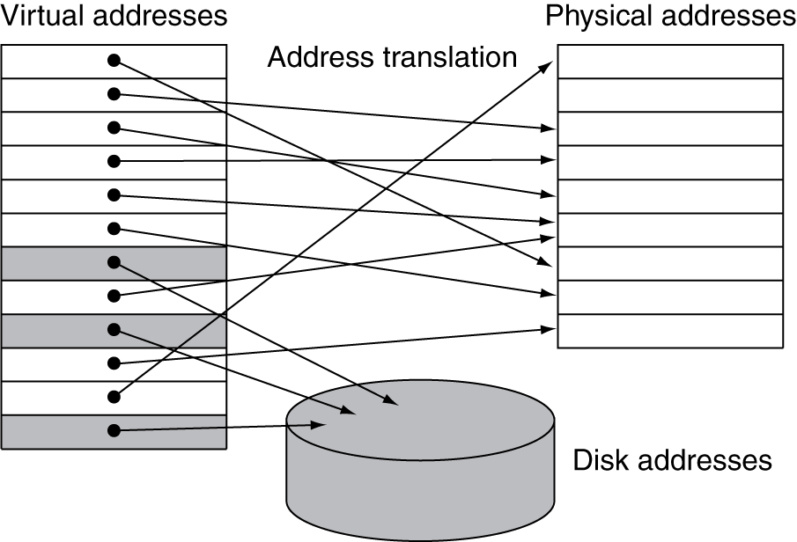
Page Fault
Page missing in Main Memory
Pages not in Main Memory are on disk:
swap-in/out

Slide 8
Mapping Virtual to Physical Address

Slide 9
Address Translation: Page Table
A page table is a
data structure containing mapping of virtual to physical pages
each process has its own page table

Slide 10
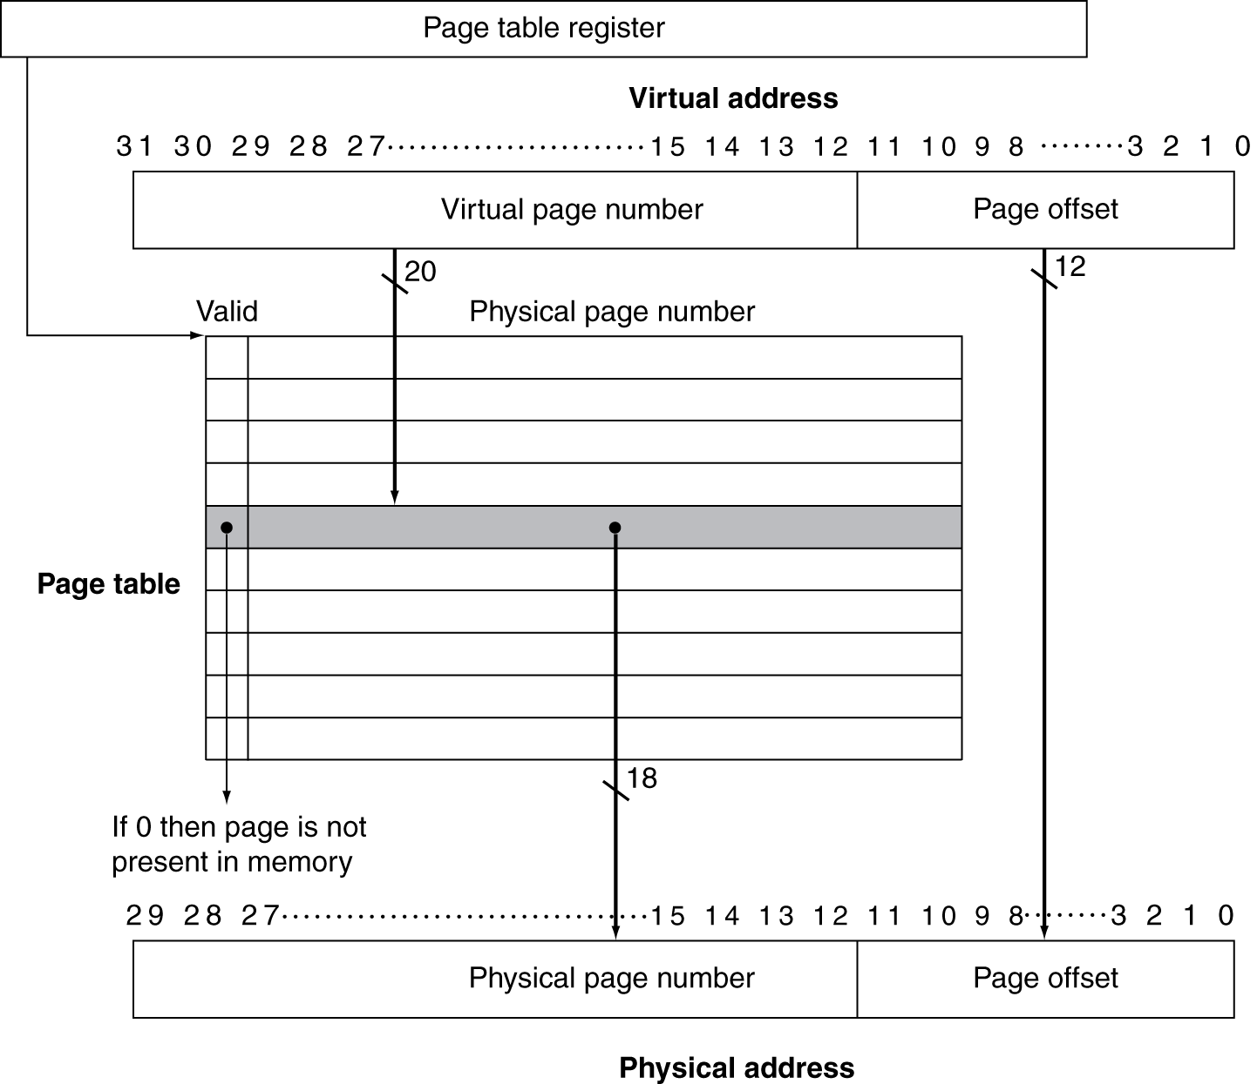
Page Table
Page table translates address

Slide 11
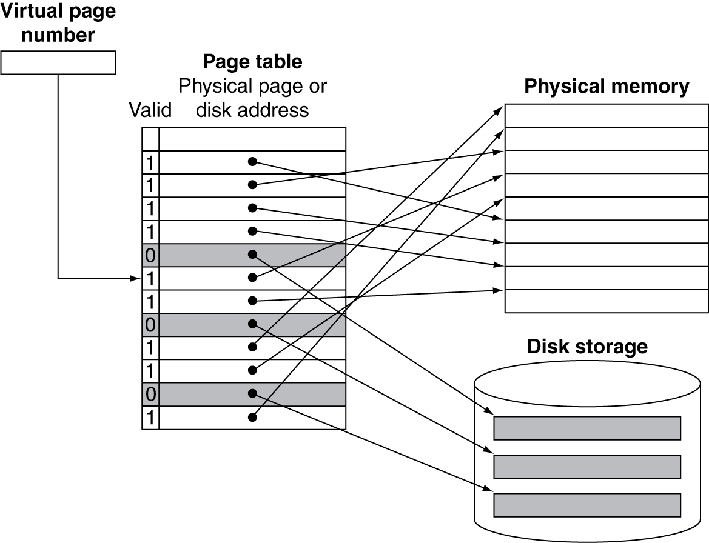
Mapping Pages to Storage

Slide 12
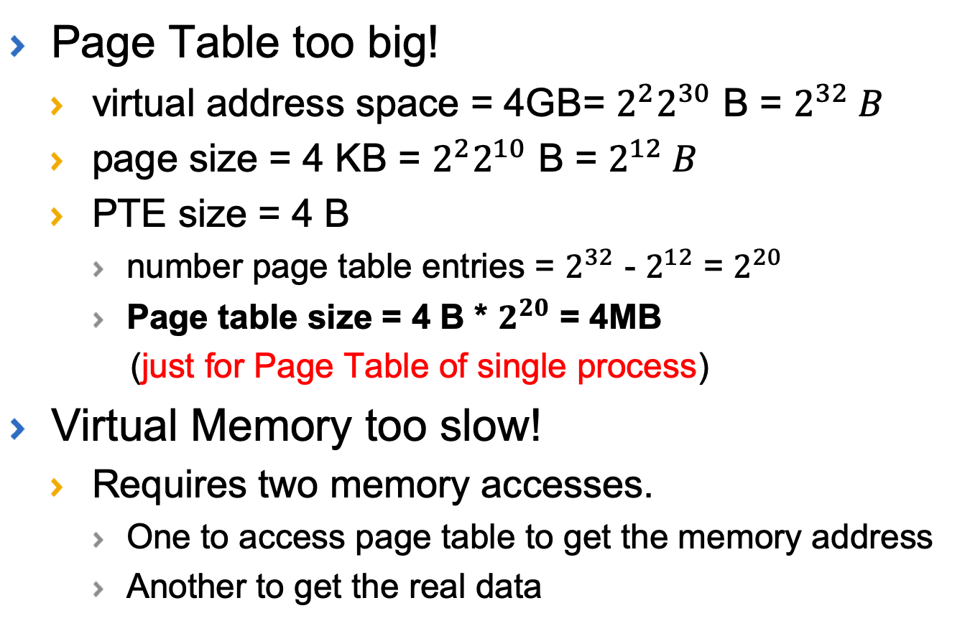
Optimizing VM
Page Table too big!
virtual address space = 4GB= $2^{2}2^{30}$ B = $2^{32} B$
page size = 4 KB = $2^{2}2^{10}$ B = $2^{12} B$
PTE size = 4 B
number page table entries = $2^{32}$ - $2^{12}$ = $2^{20}$
Page table size = 4 B * $2^{20}$ = 4MB
(just for Page Table of single process)
Virtual Memory too slow!
Requires two memory accesses.
One to access page table to get the memory address
Another to get the real data

Slide 13
Multi-level Page Table
Problem: 1-level page table too expensive for large virtual address space
Need to reduce the size of the page table
Solution: Multi-level page table, Paging page tables, etc.
To create small page tables for virtual memory
The virtual address is now split into multiple chunks to index a page table “tree”

Slide 14
Multi-level Page Table
Virtual page number broken into fields to index each level of multi-level page table
Notes:
Page Table Base Address (PTBA)

Slide 15
Fast Address Translation
Problem: Virtual Memory requires two memory accesses!
one to translate Virtual Address into Physical Address (page table lookup)
one to transfer the actual data (cache hit)
But Page Table is in physical memory! => 2 main memory accesses!
Solution: Why not create a cache of virtual to physical address translations to make translation fast? (smaller is faster)
For historical reasons, such a “page table cache” is called a Translation Lookaside Buffer, or TLB

Slide 16
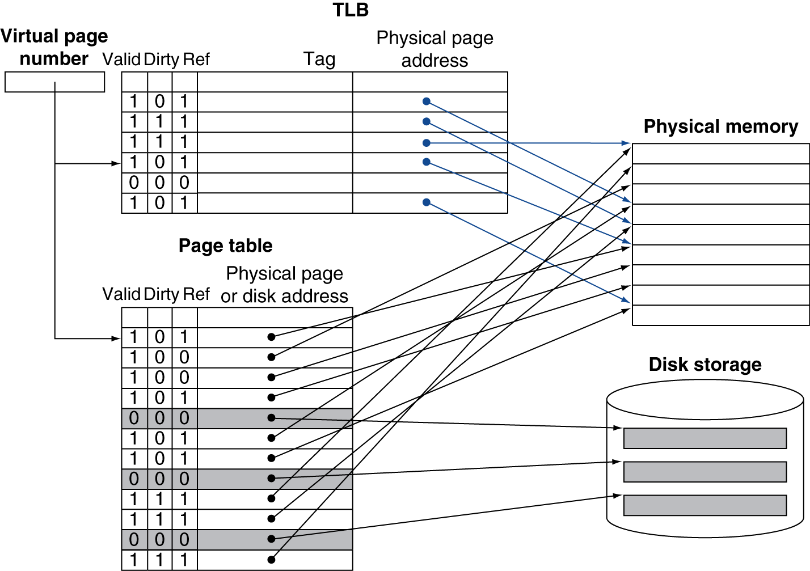
Fast Translation Using a TLB

Slide 17
TLB Translation
Virtual-to-physical address translation by a TLB and how the resulting physical address is used to access the cache memory.

Slide 18
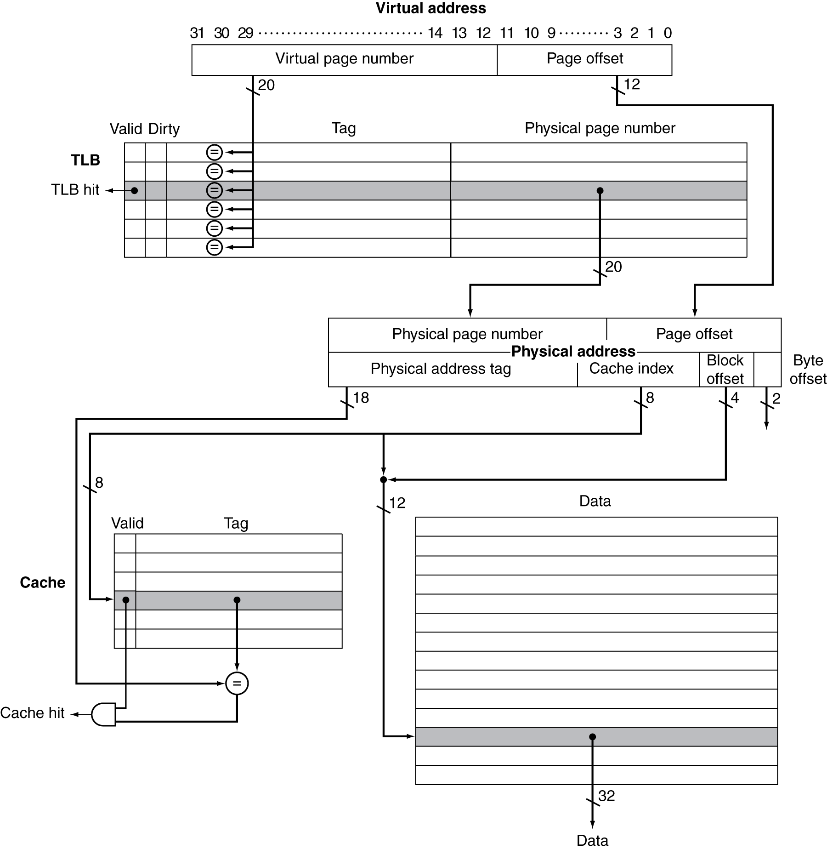
TLB and Cache Interaction
If cache tag uses physical address
Need to translate before cache lookup
Physically Indexed, Physically Tagged

Slide 19
Cache Index/Tag Options
Physically indexed, physically tagged (PIPT)
Wait for full address translation
Then use physical address for both indexing and tag comparison
Virtually indexed, physically tagged (VIPT)
Use portion of the virtual address for indexing then wait for address translation and use physical address for tag comparisons
Easiest when index portion of virtual address w/in offset (page size) address bits, otherwise aliasing may occur
Virtually indexed, virtually tagged (VIVT)
Use virtual address for both indexing and tagging…No TLB access unless cache miss
Requires invalidation of cache lines on context switch or use of process ID as part of tags

Slide 20
Summary
Virtual Memory overcomes main memory size limitations
VM supported through Page Tables
Multi-level Page Tables enables smaller page tables in memory
TLB enables fast address translation

Slide 21
Example 1
1. The following list provides parameters of a virtual memory system:
a) For a single-level page table, how many page table entries (PTEs) are needed?
Virtual Address (bits) | Physical DRAM Installed | Page Size | PTE Size (bytes)
43 | 16 GB | 4 KB | 4

Slide 22
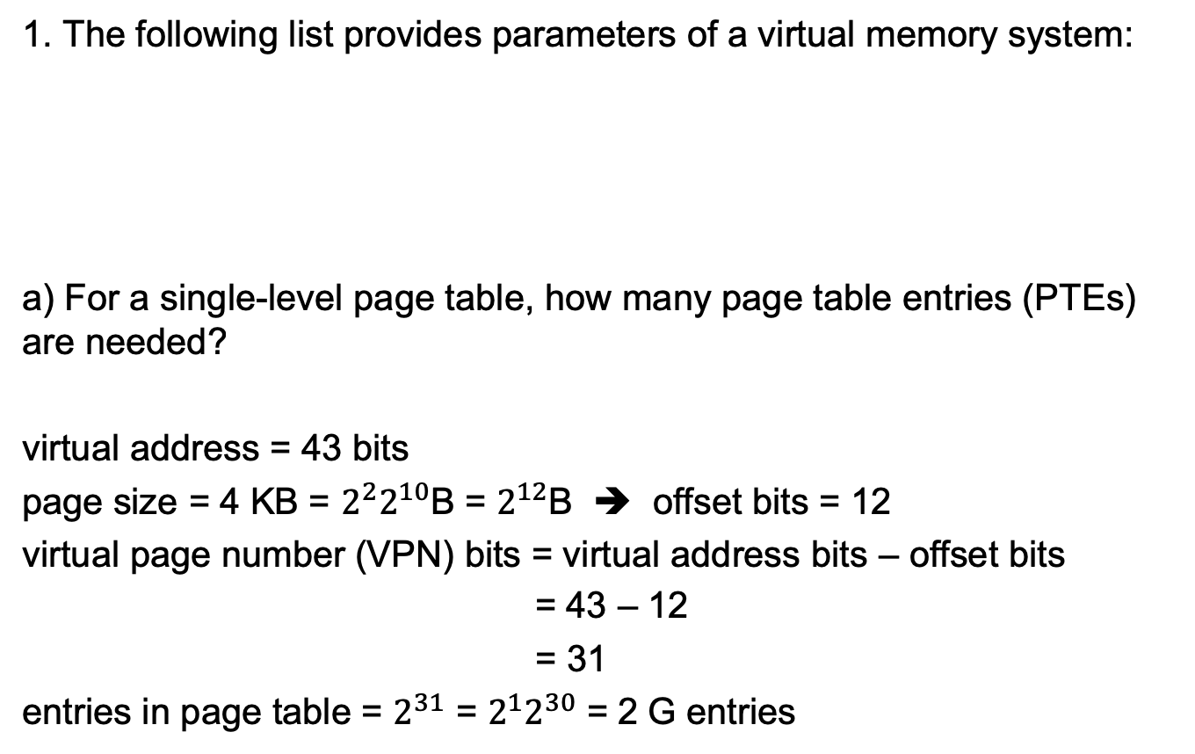
Example 1
1. The following list provides parameters of a virtual memory system:
a) For a single-level page table, how many page table entries (PTEs) are needed?
virtual address = 43 bits
page size = 4 KB = $2^{2}2^{10}$B = $2^{12}$B ➔ offset bits = 12
virtual page number (VPN) bits = virtual address bits – offset bits
= 43 – 12
= 31
entries in page table = $2^{31}$ = $2^{1}2^{30}$ = 2 G entries
Virtual Address (bits) | Physical DRAM Installed | Page Size | PTE Size (bytes)
43 | 16 GB | 4 KB | 4

Slide 23
Example 1
1. The following list provides parameters of a virtual memory system:
b) How much physical memory is needed for storing the page table?
Virtual Address (bits) | Physical DRAM Installed | Page Size | PTE Size (bytes)
43 | 16 GB | 4 KB | 4

Slide 24
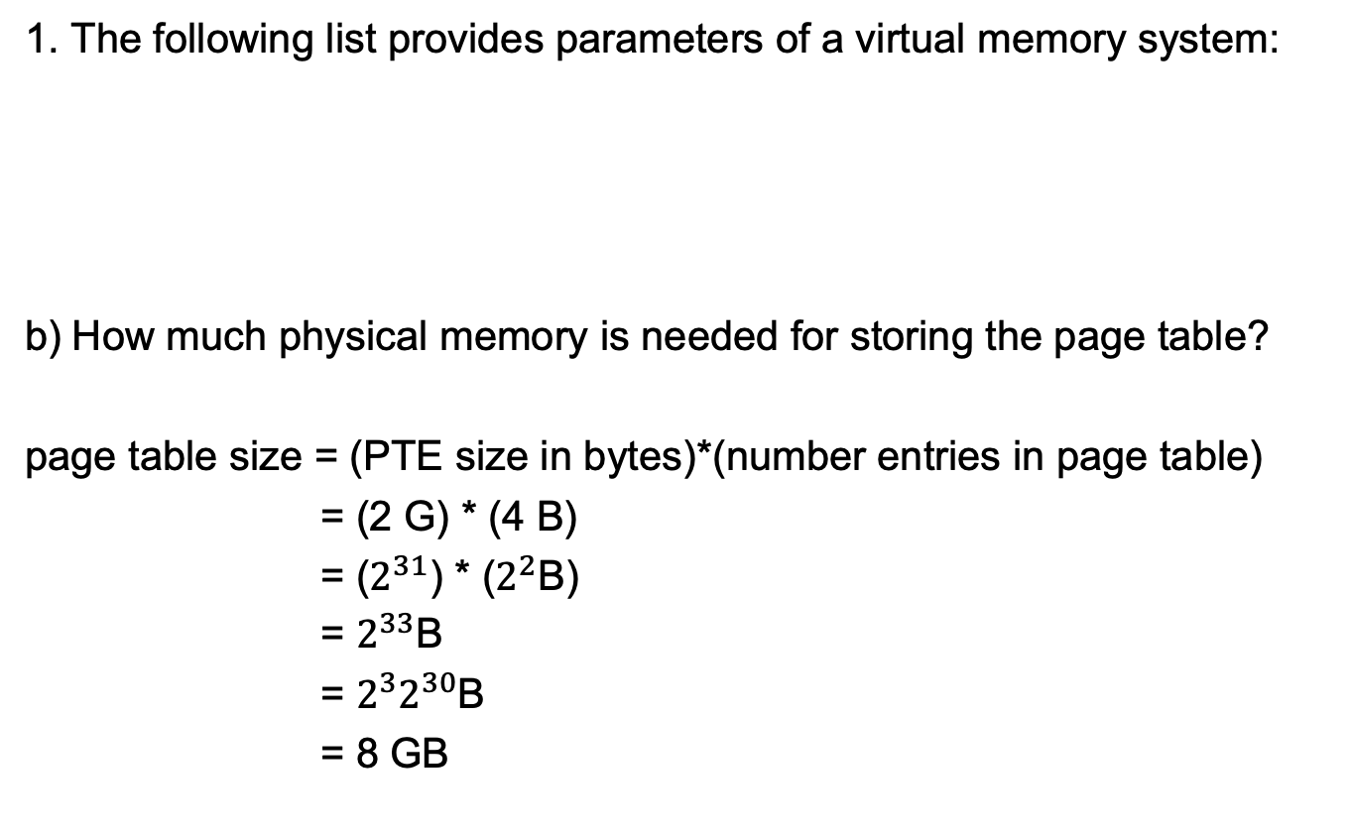
Example 1
1. The following list provides parameters of a virtual memory system:
b) How much physical memory is needed for storing the page table?
page table size = (PTE size in bytes)*(number entries in page table)
= (2 G) * (4 B)
= ($2^{31}$) * ($2^{2}$B)
= $2^{33}$B
= ${2^{3}2}^{30}$B
= 8 GB
Virtual Address (bits) | Physical DRAM Installed | Page Size | PTE Size (bytes)
43 | 16 GB | 4 KB | 4

Slide 25
Example 1
1. The following list provides parameters of a virtual memory system:
c) What is the size of secondary storage?
Virtual Address (bits) | Physical DRAM Installed | Page Size | PTE Size (bytes)
43 | 16 GB | 4 KB | 4

Slide 26
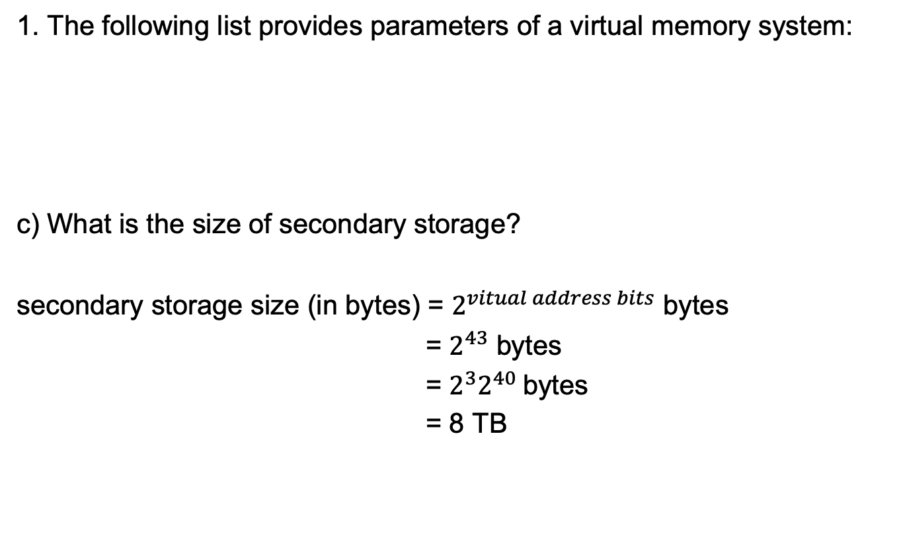
Example 1
1. The following list provides parameters of a virtual memory system:
c) What is the size of secondary storage?
secondary storage size (in bytes) = $2^{vitual address bits}$ bytes
= $2^{43}$ bytes
= $2^{3}2^{40}$bytes
= 8 TB
Virtual Address (bits) | Physical DRAM Installed | Page Size | PTE Size (bytes)
43 | 16 GB | 4 KB | 4

Slide 27
Example 1
1. The following list provides parameters of a virtual memory system:
d) How many bits of physical address are needed to address DRAM (main memory)?
Virtual Address (bits) | Physical DRAM Installed | Page Size | PTE Size (bytes)
43 | 16 GB | 4 KB | 4

Slide 28
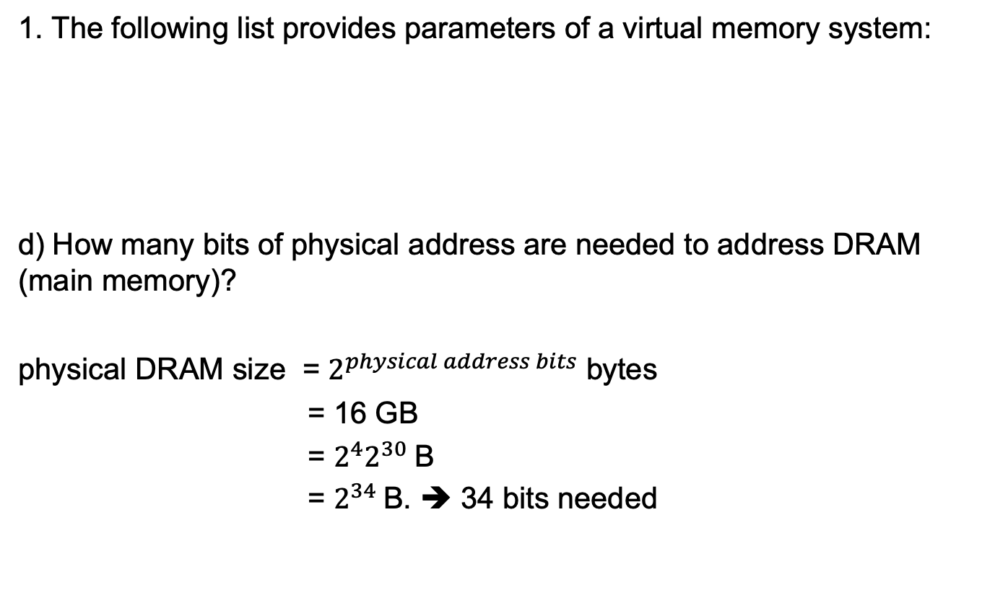
Example 1
1. The following list provides parameters of a virtual memory system:
d) How many bits of physical address are needed to address DRAM (main memory)?
physical DRAM size = $2^{physical address bits}$ bytes
= 16 GB
= $2^{4}2^{30}$B
= $2^{34}$B. ➔ 34 bits needed
Virtual Address (bits) | Physical DRAM Installed | Page Size | PTE Size (bytes)
43 | 16 GB | 4 KB | 4

Slide 29
Example 2
2. Using a multi-level page table with the following list provides parameters of a virtual memory system:
a) How many levels of page tables will be needed in this case?
Virtual Address (bits) | Physical DRAM Installed | Page Size | PTE Size (bytes)
43 | 16 GB | 4 KB | 4

Slide 30
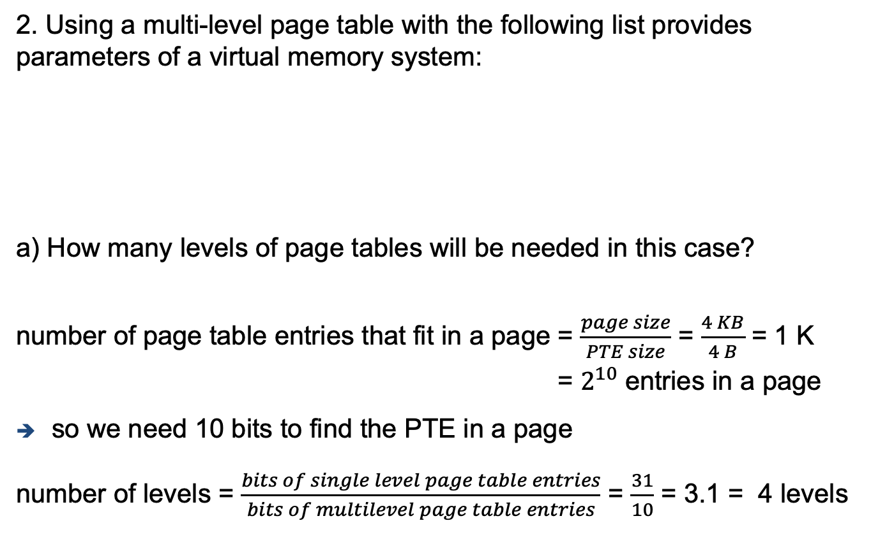
Example 2
2. Using a multi-level page table with the following list provides parameters of a virtual memory system:
a) How many levels of page tables will be needed in this case?
number of page table entries that fit in a page = $\frac{page size}{PTE size}$ = $\frac{4 KB}{4 B}$ = 1 K
= $2^{10}$ entries in a page
so we need 10 bits to find the PTE in a page
number of levels = $\frac{bits of single level page table entries}{bits of multilevel page table entries}$ = $\frac{31}{10}$ = 3.1 = 4 levels
Virtual Address (bits) | Physical DRAM Installed | Page Size | PTE Size (bytes)
43 | 16 GB | 4 KB | 4

Slide 31
Example 2
2. Using a multi-level page table with the following list provides parameters of a virtual memory system:
b) How many memory references are needed for address translation if missing in TLB?
Virtual Address (bits) | Physical DRAM Installed | Page Size | PTE Size (bytes)
43 | 16 GB | 4 KB | 4

Slide 32
Example 2
2. Using a multi-level page table with the following list provides parameters of a virtual memory system:
b) How many memory references are needed for address translation if missing in TLB?
if there is a miss in the TLB for address translation, then 4 memory references are required, one for each level
Virtual Address (bits) | Physical DRAM Installed | Page Size | PTE Size (bytes)
43 | 16 GB | 4 KB | 4

Slide 33
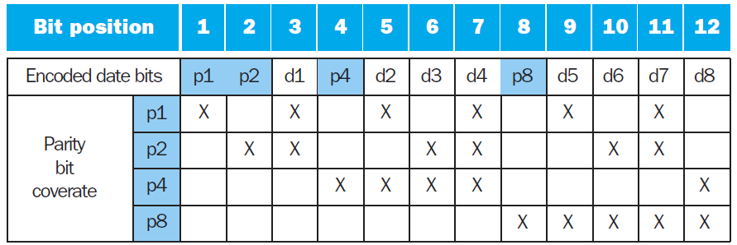
Example 3
3. Given the following parity bits, data bits, and field coverage in a Hamming ECC code for eight data bits (i.e., a [12,8] encoding):
a) decode the bits for the value 0x9A.

Slide 34
Example 3
3. Given the following parity bits, data bits, and field coverage in a Hamming ECC code for eight data bits (i.e., a [12,8] encoding):
a) decode the bits for the value 0x9A.
0x9A = 1001 1010 = 10011010
So there’s eight data bits (8) and we’re using 12 bit parity encoding, so we will have 4 bits for parity bits, which we will put in spots 1, 2, 4, and 8, so we leave a blank there for now:
_ _1_001_1010
p1 checks every other spot (1 position in between), so positions 1,3,5,7,9, and 11, the positions are highlighted in red:
_ _1_001_1010
since there are four 1’s highlighted, then we should set the first bit (i.e., the p1 bit) to 0 to keep the group’s parity at an even number:
0_1_001_1010

Slide 35
Example 3
3. Given the following parity bits, data bits, and field coverage in a Hamming ECC code for eight data bits (i.e., a [12,8] encoding):
a) decode the bits for the value 0x9A.
next we look at the case for p2, checking every two bits (highlighted in red), so we’re checking positions 2,3,6,7,10,and 11:
0_1_001_1010
since there are three 1’s highlighted, then we should set the second bit (i.e., the p2 bit) to 1 to make the group’s parity at an even number:
011_001_1010
next we look at the case for p4, checking every four bits (highlighted in red), so we’re checking positions 4,5,6,7,and 12:
011_001_1010

Slide 36
Example 3
3. Given the following parity bits, data bits, and field coverage in a Hamming ECC code for eight data bits (i.e., a [12,8] encoding):
a) decode the bits for the value 0x9A.
since there is only one 1 highlighted, then we should set the fourth bit (i.e., the p4 bit) to 1 to make the group’s parity at an even number:
0111001_1010
finally, we look at the case for p8, checking every eight bits (highlighted in red), so we’re checking positions 8,9,10,11,and 12:
0111001_1010
since there are two 1’s highlighted, then we should set the eighth bit (i.e., the p8 bit) to 0 to keep the group’s parity at an even number:
011100101010
this leaves us with the following final code word:
011100101010

Slide 37
Example 3
3. Given the following parity bits, data bits, and field coverage in a Hamming ECC code for eight data bits (i.e., a [12,8] encoding):
a) decode the bits for the value 0x9A.
but let’s assume that the following was received instead (bit 10 was flipped):
011100101110
so to check if there was an error, we would check the parity and compare them with their respective parity bits:
p1: 011100101110 → four 1’s (even) without parity bit and parity bit is 0 (even) → no error
p2: 011100101110 → four 1’s (even) without parity bit and parity bit is 1 (odd) → error
p4: 011100101110 → one 1’s (odd) without parity bit and parity bit is 1 (odd) → no error
p8: 011100101110 → three 1’s (odd) without parity bit and parity bit is 0 (even) → error
since parity bits 2 (p2) and 8 (p8) are incorrect, then bit 10 must be wrong (2+8=10)
011100101110 → 011100101010

